Slide 1
Introduction to Energy Modeling
Görkem Güngör
E-mail: ggungor@hacettepe.edu.tr

Slide 2
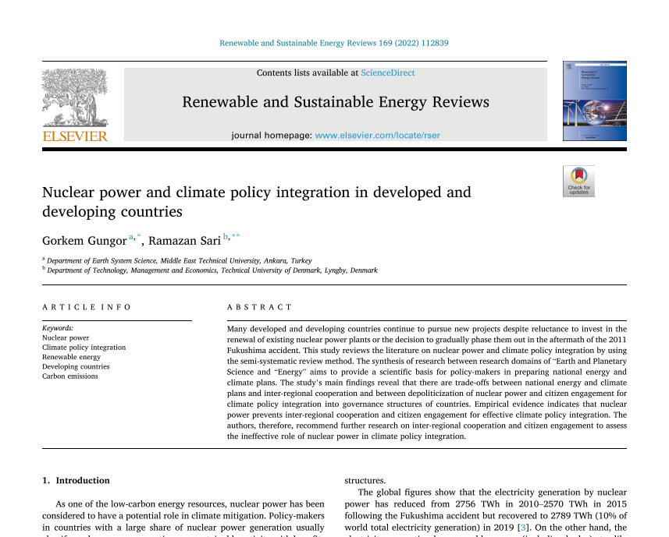
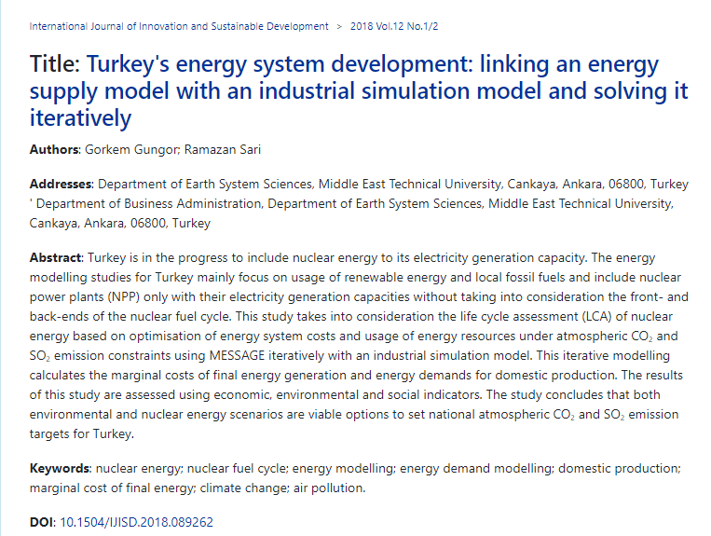
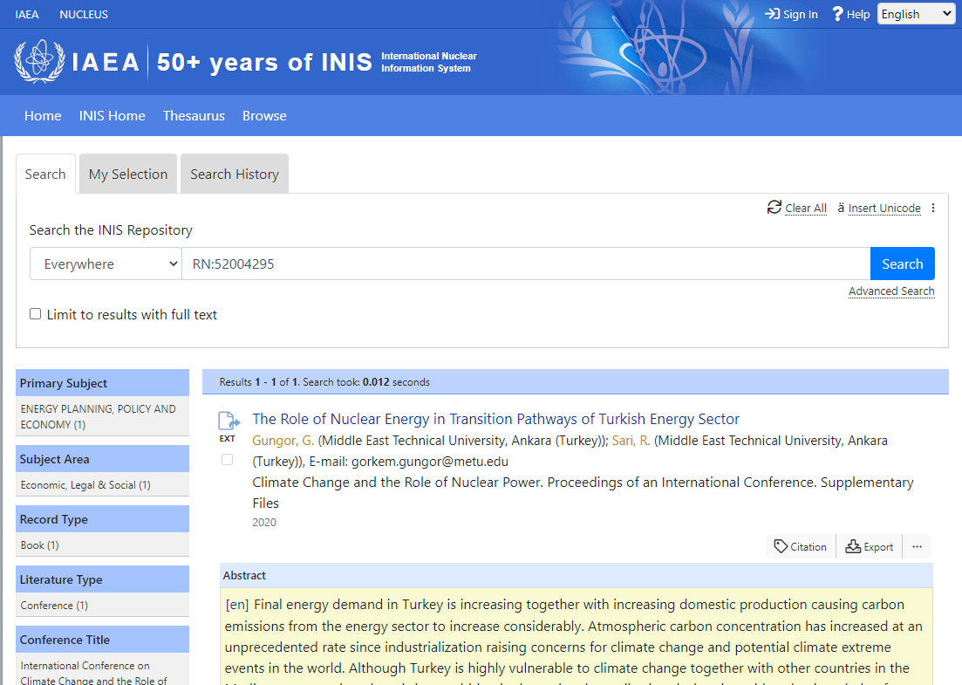
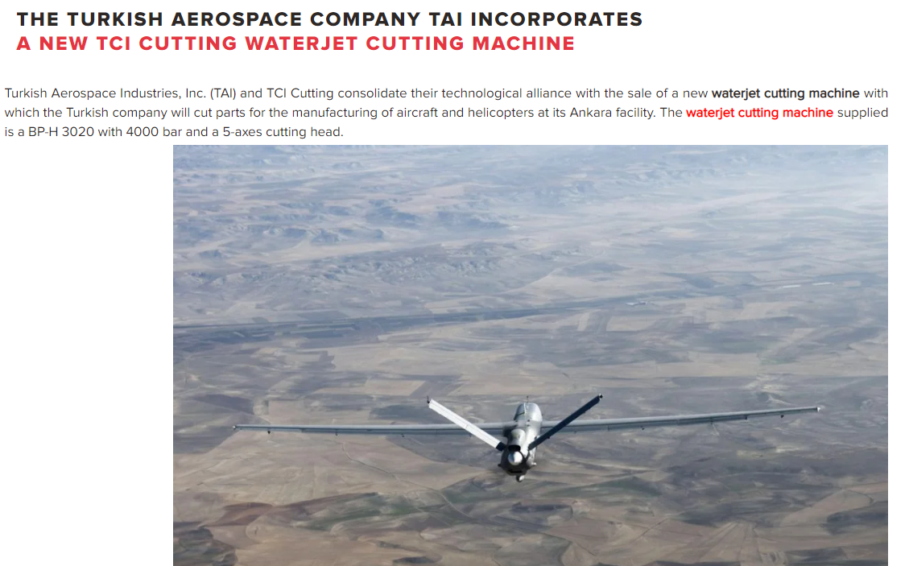
About myself: education, employment and research carreer
BS in Nuclear Engineering at Hacettepe University, modelling of TRIGA reactor with MCNP
Sales person in chemical and mechanical industries
Energy expert at Ministry of Energy and Natural Resources
MS in Earth System Science at Middle East Technical University, mathematical modeling of Turkish energy system
Notes:
https://www.tcicutting.com/blog/the-turkish-aerospace-company-tai-incorporates-a-new-tci-cutting-waterjet-cutting-machine/
https://yunus.hacettepe.edu.tr/~nem65/report/index.html
Gungor, G, & Sari, R. (2020). The Role of Nuclear Energy in Transition Pathways of Turkish Energy Sector. In The potential role of nuclear energy in national climate change mitigation strategies : final report of a coordinated research project. IAEA. http://inis.iaea.org/search/search.aspx?orig_q=RN:52004295
Gungor, G., & Sari, R. (2018). Turkey’s energy system development: linking an energy supply model with an industrial simulation model and solving it iteratively. International Journal of Innovation and Sustainable Development, 12(1/2), 44. https://doi.org/10.1504/IJISD.2018.089262
Gungor, G., & Sari, R. (2022). Nuclear power and climate policy integration in developed and developing countries. Renewable and Sustainable Energy Reviews, 169(June), 112839. https://doi.org/10.1016/j.rser.2022.112839

Slide 3
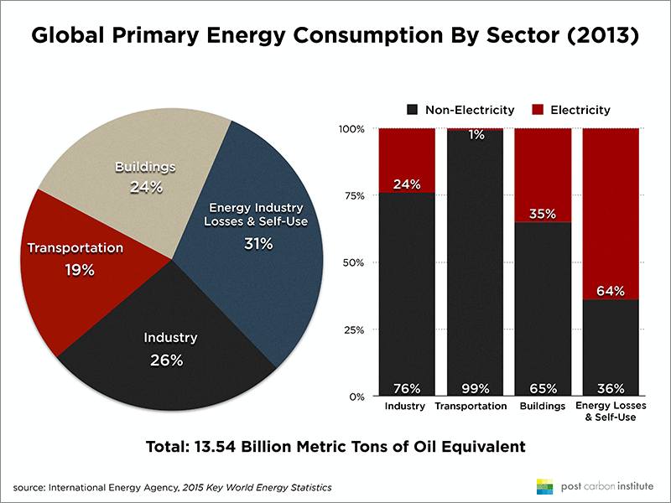
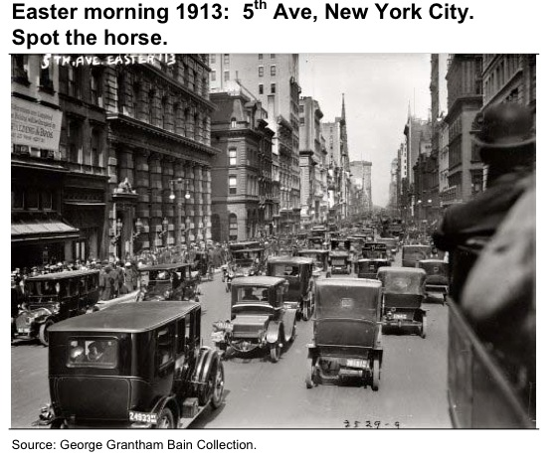
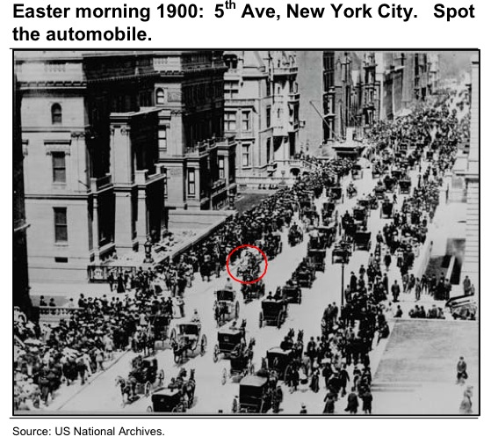
Energy Demand
Meeting our daily needs (electricity, heating, cooling, cooking, etc.)
Driver of industrialization
Mobilization and transportation
Improving well being and comfort
Modernization of society
Digitalization and the need for electricity
Notes:
https://teaching.ece.iiasa.ac.at/lectures/global-entrans-tuwien/index.html
https://www.iea.org/sankey/

Slide 4
Energy Flow
Notes:
Getcp-tuwien

Slide 5
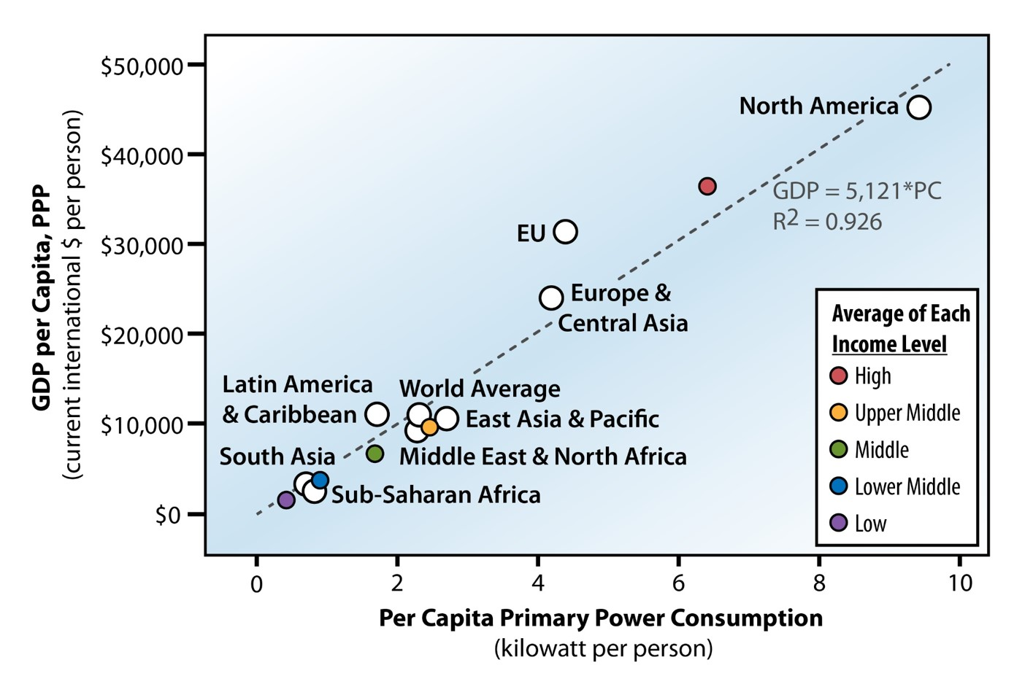
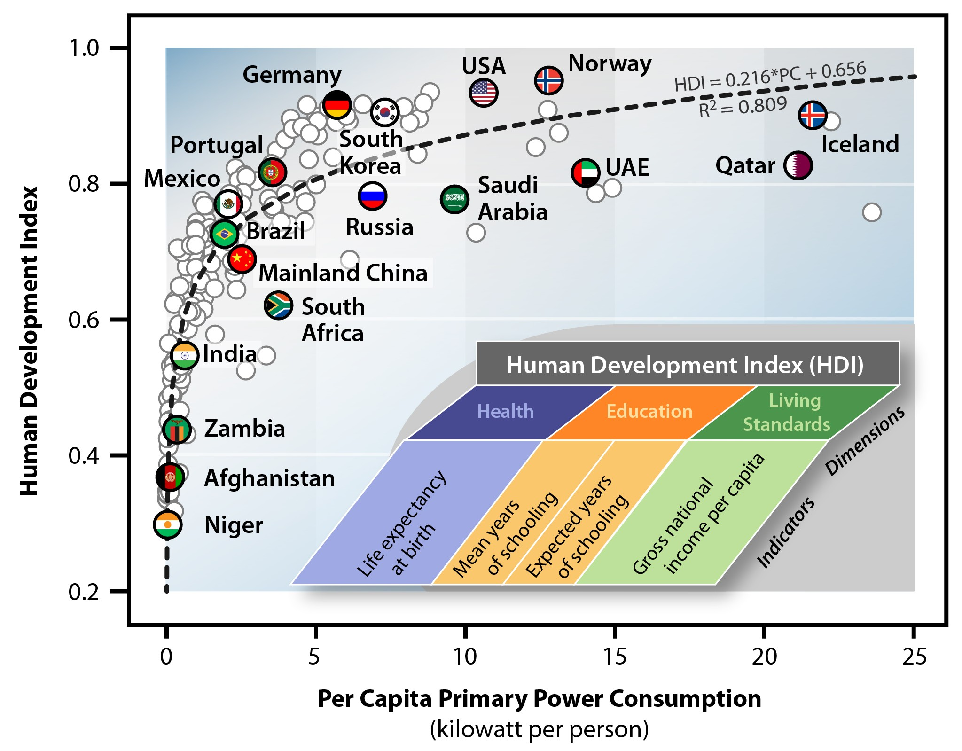
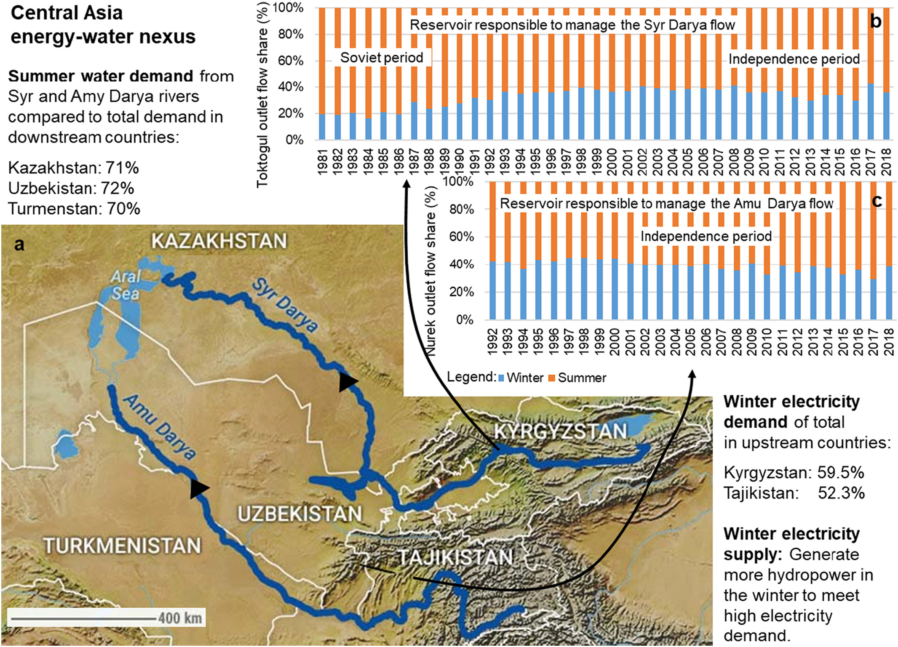
Energy and Development
Countries dependent on fossil fuels wants to protect their resource rents
A sustainable society is achievable at 2-4 kW primary power consumption per capita
Renewable energy depends more on physics and geology instead of politics and economics
Land-water-energy-food nexus linked with transboundary waters (Central Asia, Middle East)
Notes:
https://www.ourenergypolicy.org/growing-poor-slowly-why-we-must-have-renewable-energy/

Slide 6
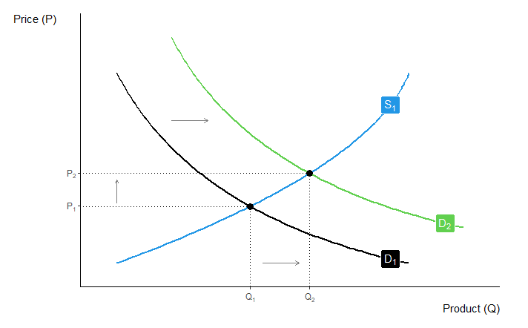
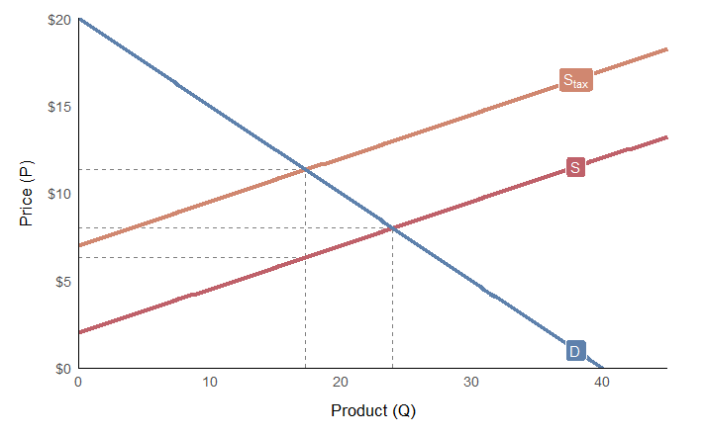
Energy Balance
How does the energy market come to equilibrium?
How does it adjust if energy supply or energy demand shifts?
What are the producer surplus and consumer surplus before and after equilibrium?
What happens if government regulates the price or the quantity?
Notes:
Uğur Soytaş
José Carlos Soage González and Andrew Heiss (2020). econocharts: Microeconomics and Macroeconomics Charts Made with 'ggplot2'. R package version 1.0. https://r-coder.com/, https://r-coder.com/economics-charts-r/.

Slide 7
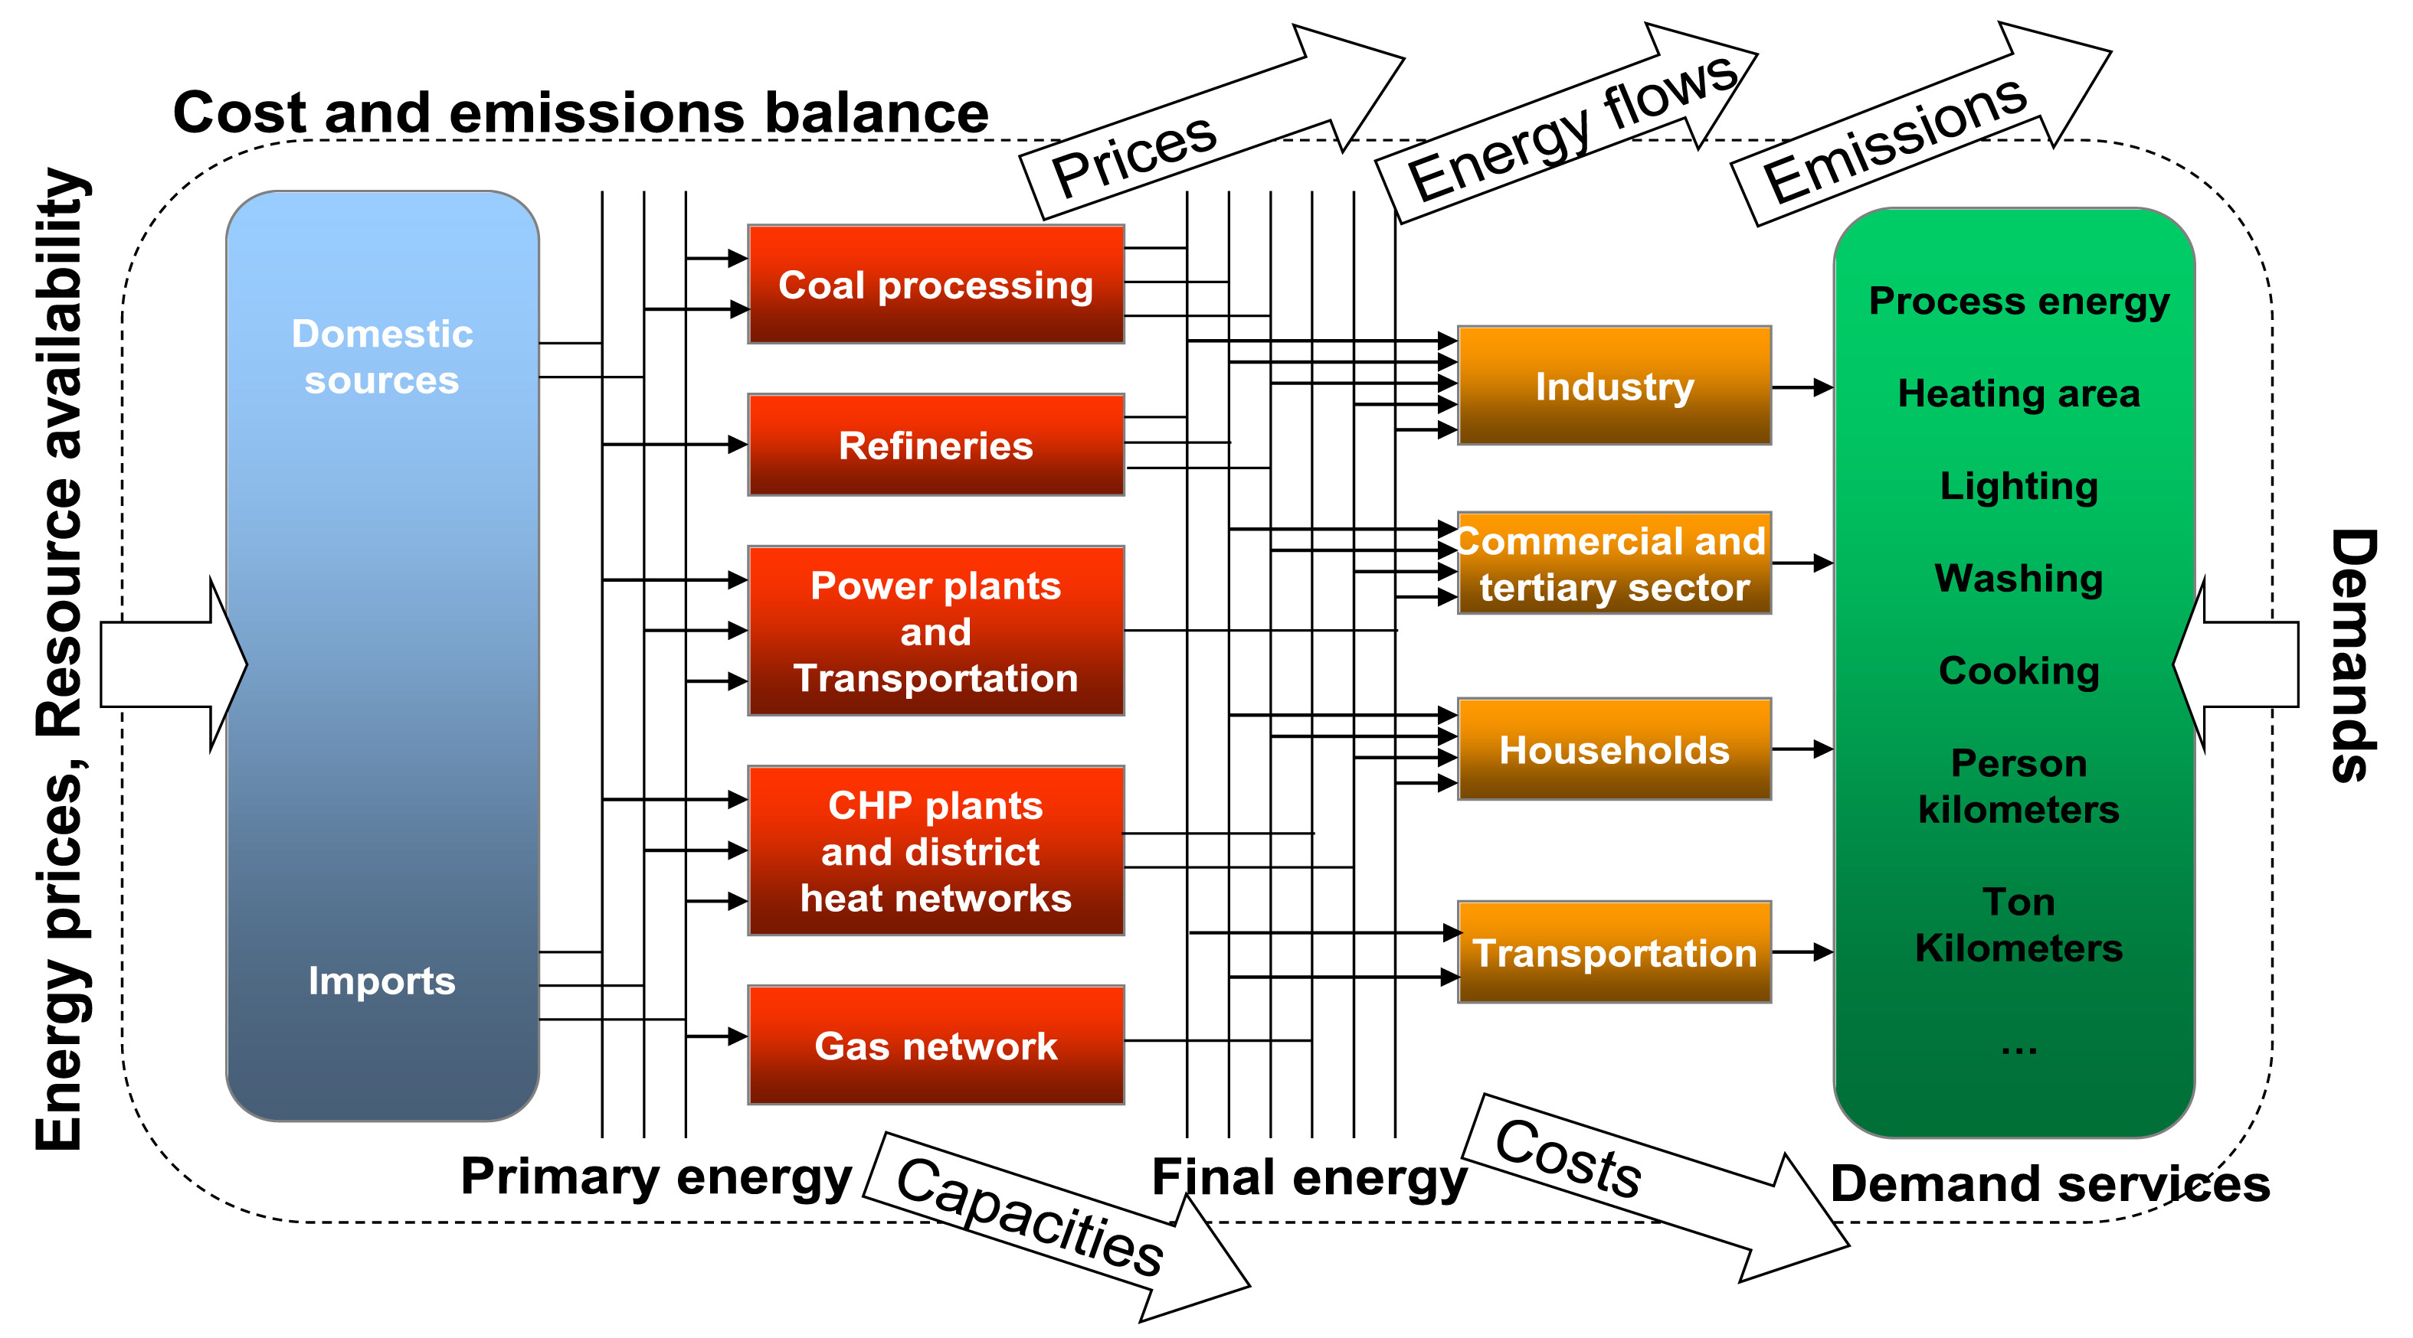
Energy Demand
Internalization of external costs affects the least cost optimization modeling solutions
The modeling studies show that up to 80% reduction of Paris Agreement target is possible by combining demand and supply side strategies
Further reduction of carbon emissions is possible with the expansion of negative emission technologies (CCS, BECCS)

Slide 8
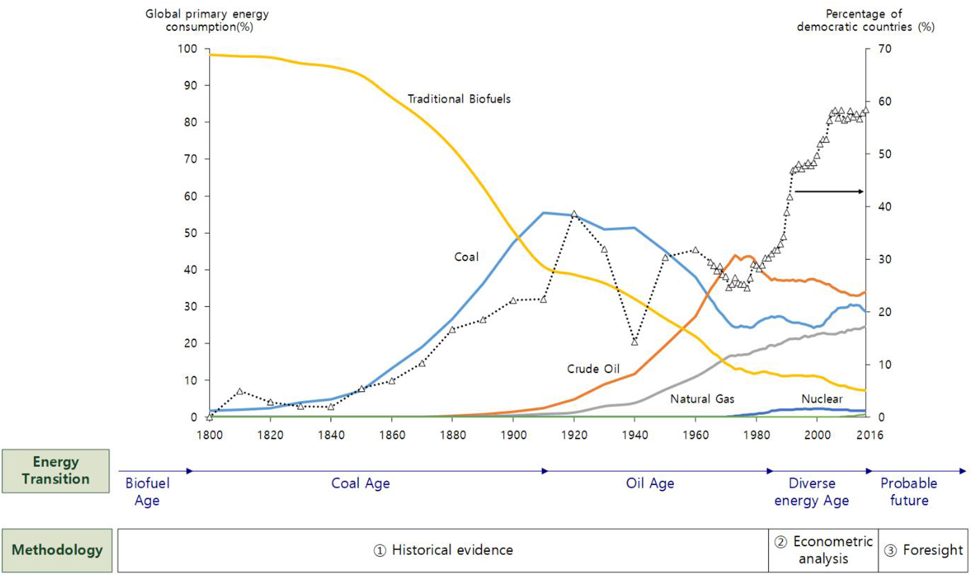
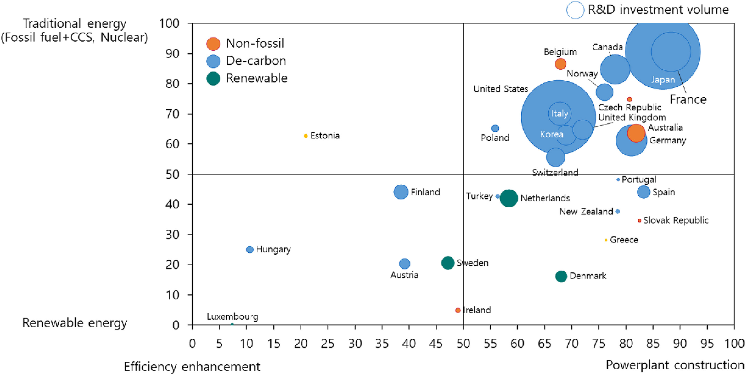
Energy Transition
Energy systems affected political systems in the past which is reversed now with even democratic countries resisting to low carbon transition
Democratic countries are relatively less dependent on fossil fuels which can be attributed to citizen participation to policy making and market centered economic structures
Notes:
Lee, J., & Yang, J. S. (2019). Global energy transitions and political systems. Renewable and Sustainable Energy Reviews, 115(August), 109370. https://doi.org/10.1016/j.rser.2019.109370

Slide 9
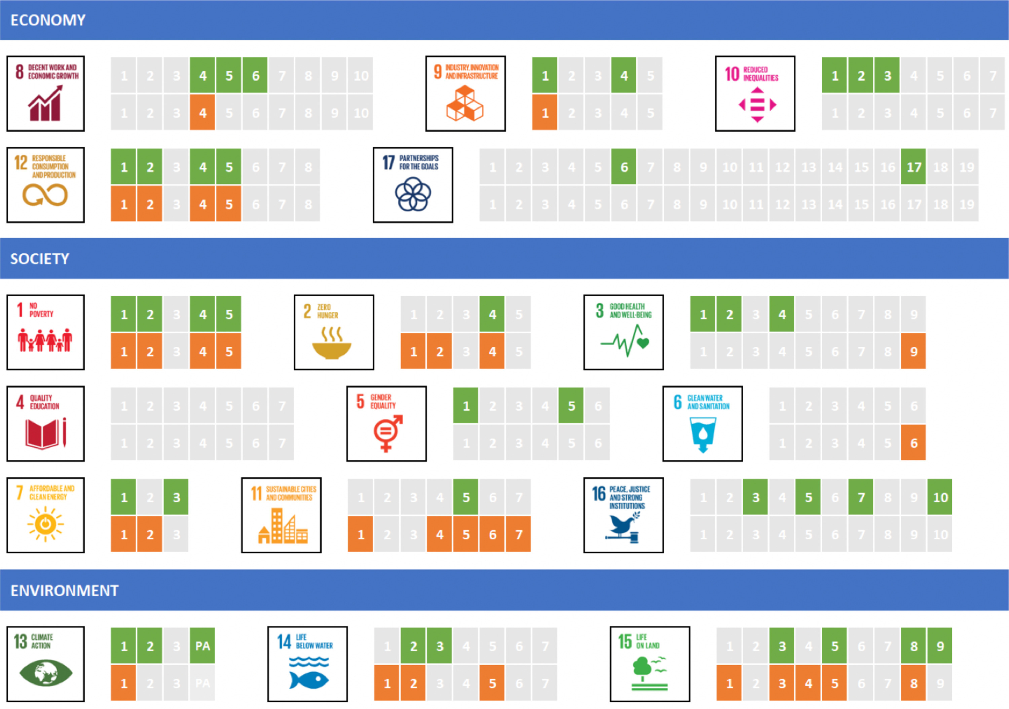
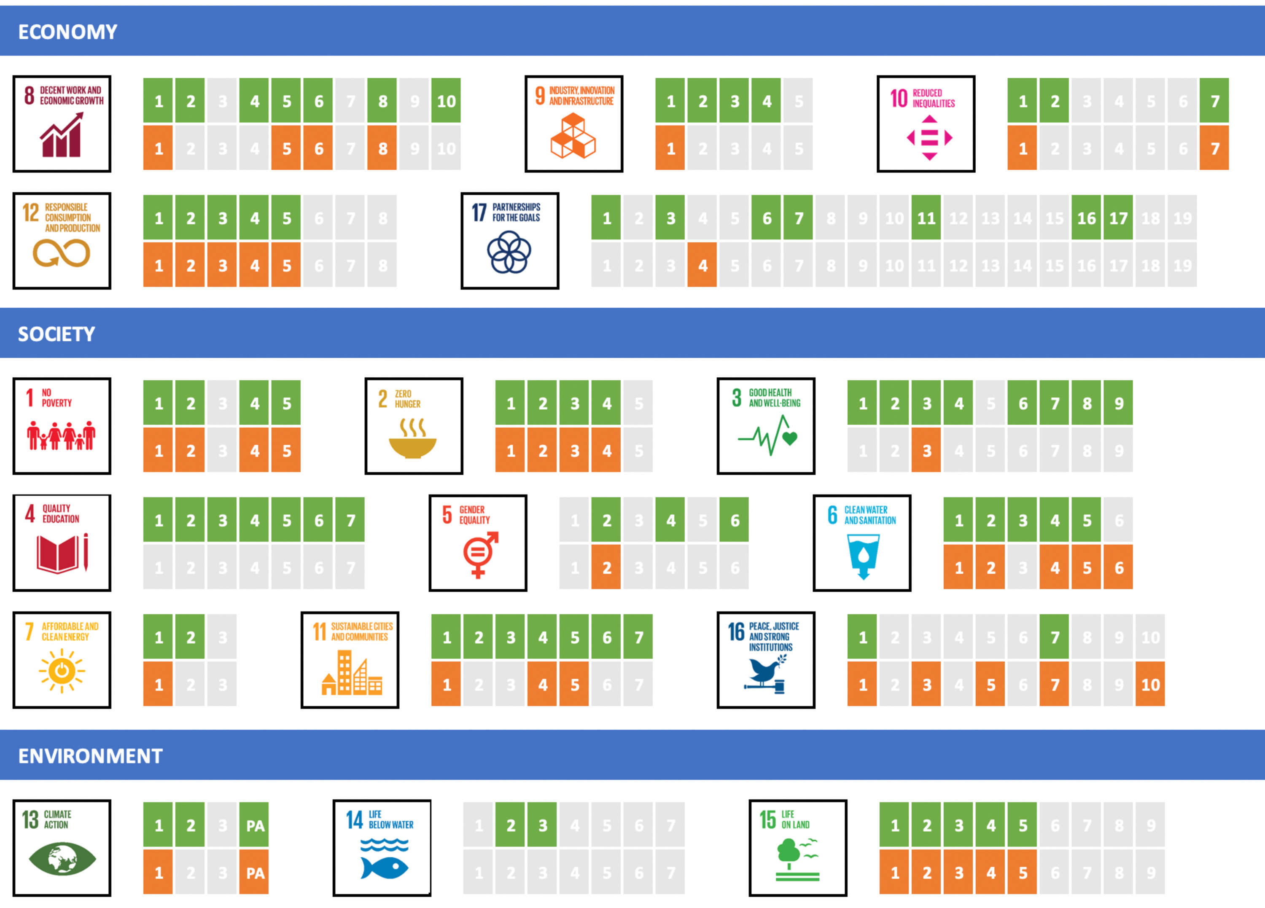
Paris Agreement & SDGs
The 2030 UN Agenda for Sustainable Development is comprised of 17 goals with 169 interlinked targets
Action for sustainable development, covers areas from poverty eradication and the provision of basic services to combating climate change and reducing inequalities
The synergies and trade-offs between the goals depend on project governance, characteristics and outcomes
Results of application of the SDGs-IAE Framework to the HPC
Results of application of the SDGs-IAE Framework to the GERD
Notes:
Castor, J., Bacha, K., & Fuso Nerini, F. (2020). SDGs in action: A novel framework for assessing energy projects against the sustainable development goals. Energy Research & Social Science, 68(January), 101556. https://doi.org/10.1016/j.erss.2020.101556

Slide 10
Interdisciplinary Framework
Before science the overlap of society and space weather in the form of low altitude auroras that acompany space storms gave rise to omens and wonders
Space Weather
Science
Society
The overlap of space weather and science has given rise to the fields of space physics and aeronomy
Omen Wonders
Space Physics
Cyber-electrosphere
The cyberelectrosphere denotes a global, electrically enabled, technological environment that space storms attack
Those components of which that are vulnerable to space weather distrubances form the cyberelectrosphere at the center of the triquetra
Technology
Notes:
Siscoe, G. (2000). The space-weather enterprise: past, present, and future. Journal of Atmospheric and Solar-Terrestrial Physics, 62(14), 1223–1232. https://doi.org/10.1016/S1364-6826(00)00074-2
http://bit.ly/2Z3XJrt

Slide 11
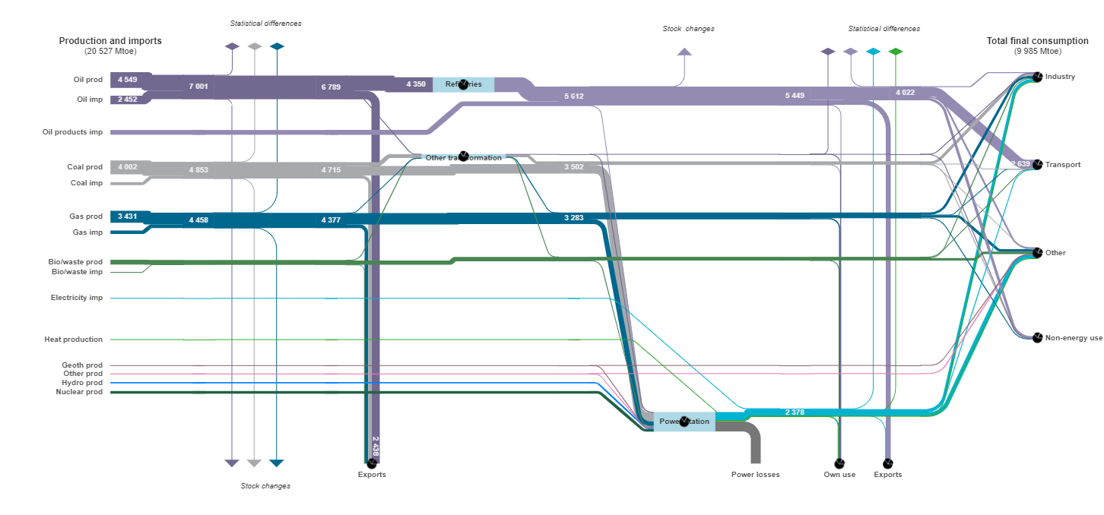
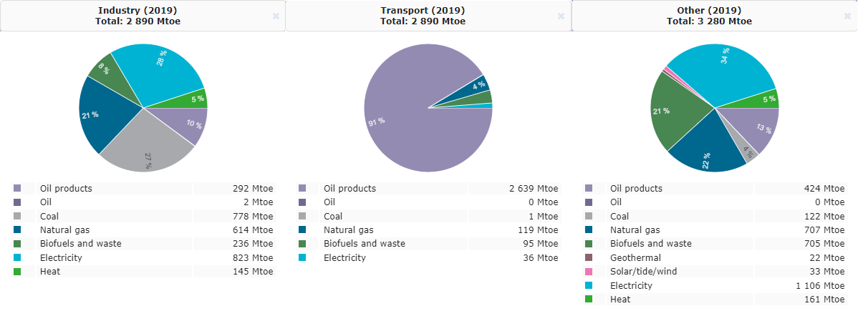
Energy Statistics

Slide 12
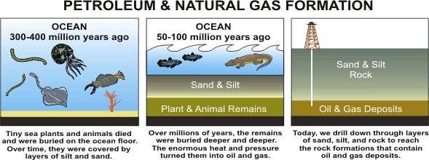
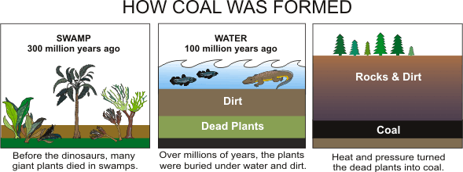
Fossil Fuels
Fossil fuel formation was on geological timescale
Fossil fuel consumption is on human generations scale since pre-industrial period (1850-1900)
Fossil fuels supply 85% of the world’s energy consumption
Is the peak oil theory valid? When will it happen?
Is a low carbon energy system possible? Can wind and solar energy save our climate?
Notes:
https://ei.lehigh.edu/learners/energy/fossils5.html
https://ei.lehigh.edu/learners/energy/fossils6.html

Slide 13

Oil Market
Energy resource and financial commodity
The impact of supply, demand, stocks and imports changes during regimes
Resource curse prevents savings and investment to other sectors
States try to overcome the resource curse with diversification of investments and saving for future
Regime | Begin | End | Number of Months
Pre-Bubble | January 1986 | December 2001 | 180
Bubble Forming | January 2001 | November 2007 | 83
Crisis | December 2007 | May 2009 | 18
After Crisis | June 2009 | May 2013 | 48
Pre-Recent | June 2013 | December 2020 | 91
Notes:
Malliaris, A. G., & Malliaris, M. (2021). What Microeconomic Fundamentals Drove Global Oil Prices during 1986–2020? Journal of Risk and Financial Management, 14(8), 391. https://doi.org/10.3390/jrfm14080391
https://www.lifeinnorway.net/norways-oil-fund-passes-10-trillion-kroner/

Slide 14
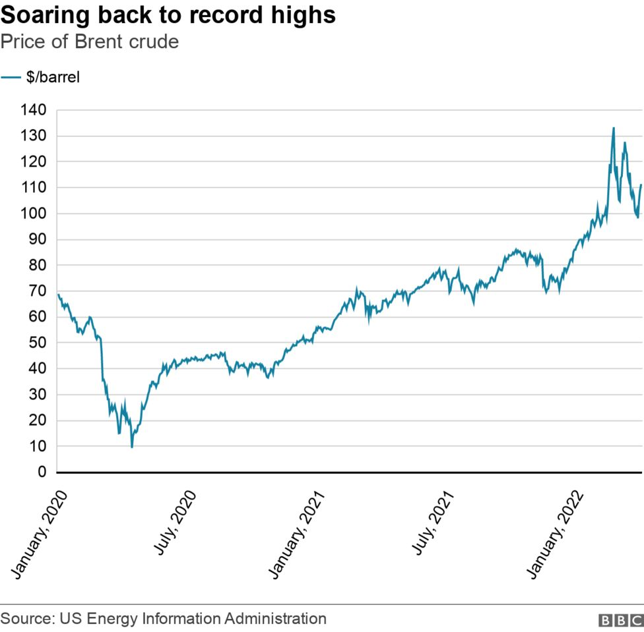
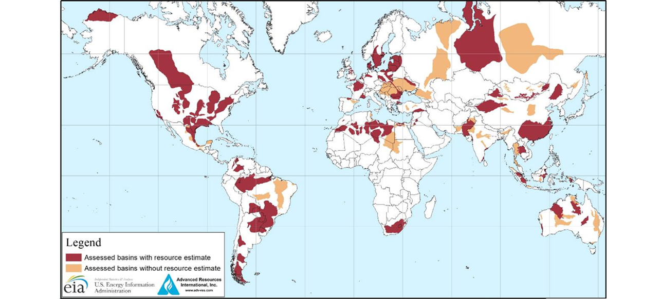
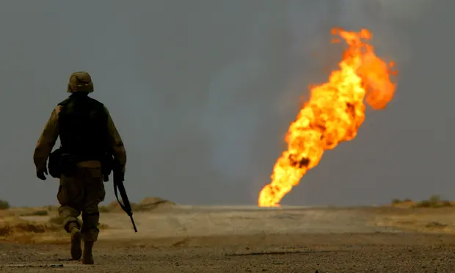
Oil Market
Oil is not just oil!
Influence of big suppliers, e.g., OPEC (40% oil reserves)
Oil trade is based on “future contracts”
Demand for oil and products
Risks related to geopolitical conflicts
Accidents, natural disasters and disruptions in oil supply
Supply increase (shale gas and oil)
Notes:
https://www.theguardian.com/commentisfree/2019/sep/18/climate-crisis-oil-war-iraq-saudi-attack-green-Energy
https://www.bbc.com/news/business-61188579
https://www.eia.gov/todayinenergy/images/2013.06.10/bigmap.png

Slide 15
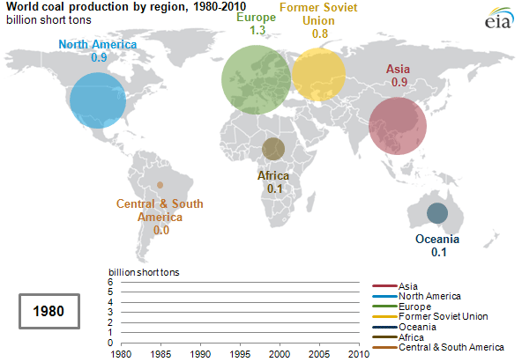
Coal Market
Coal reserves are abundant and distributed around the World
The lowest cost fossil fuel with rather stable prices
The most polluting and carbon intensive fuel
Responsible for 40% of world electricity production
Notes:
https://www.eia.gov/todayinenergy/detail.php?id=4210

Slide 16
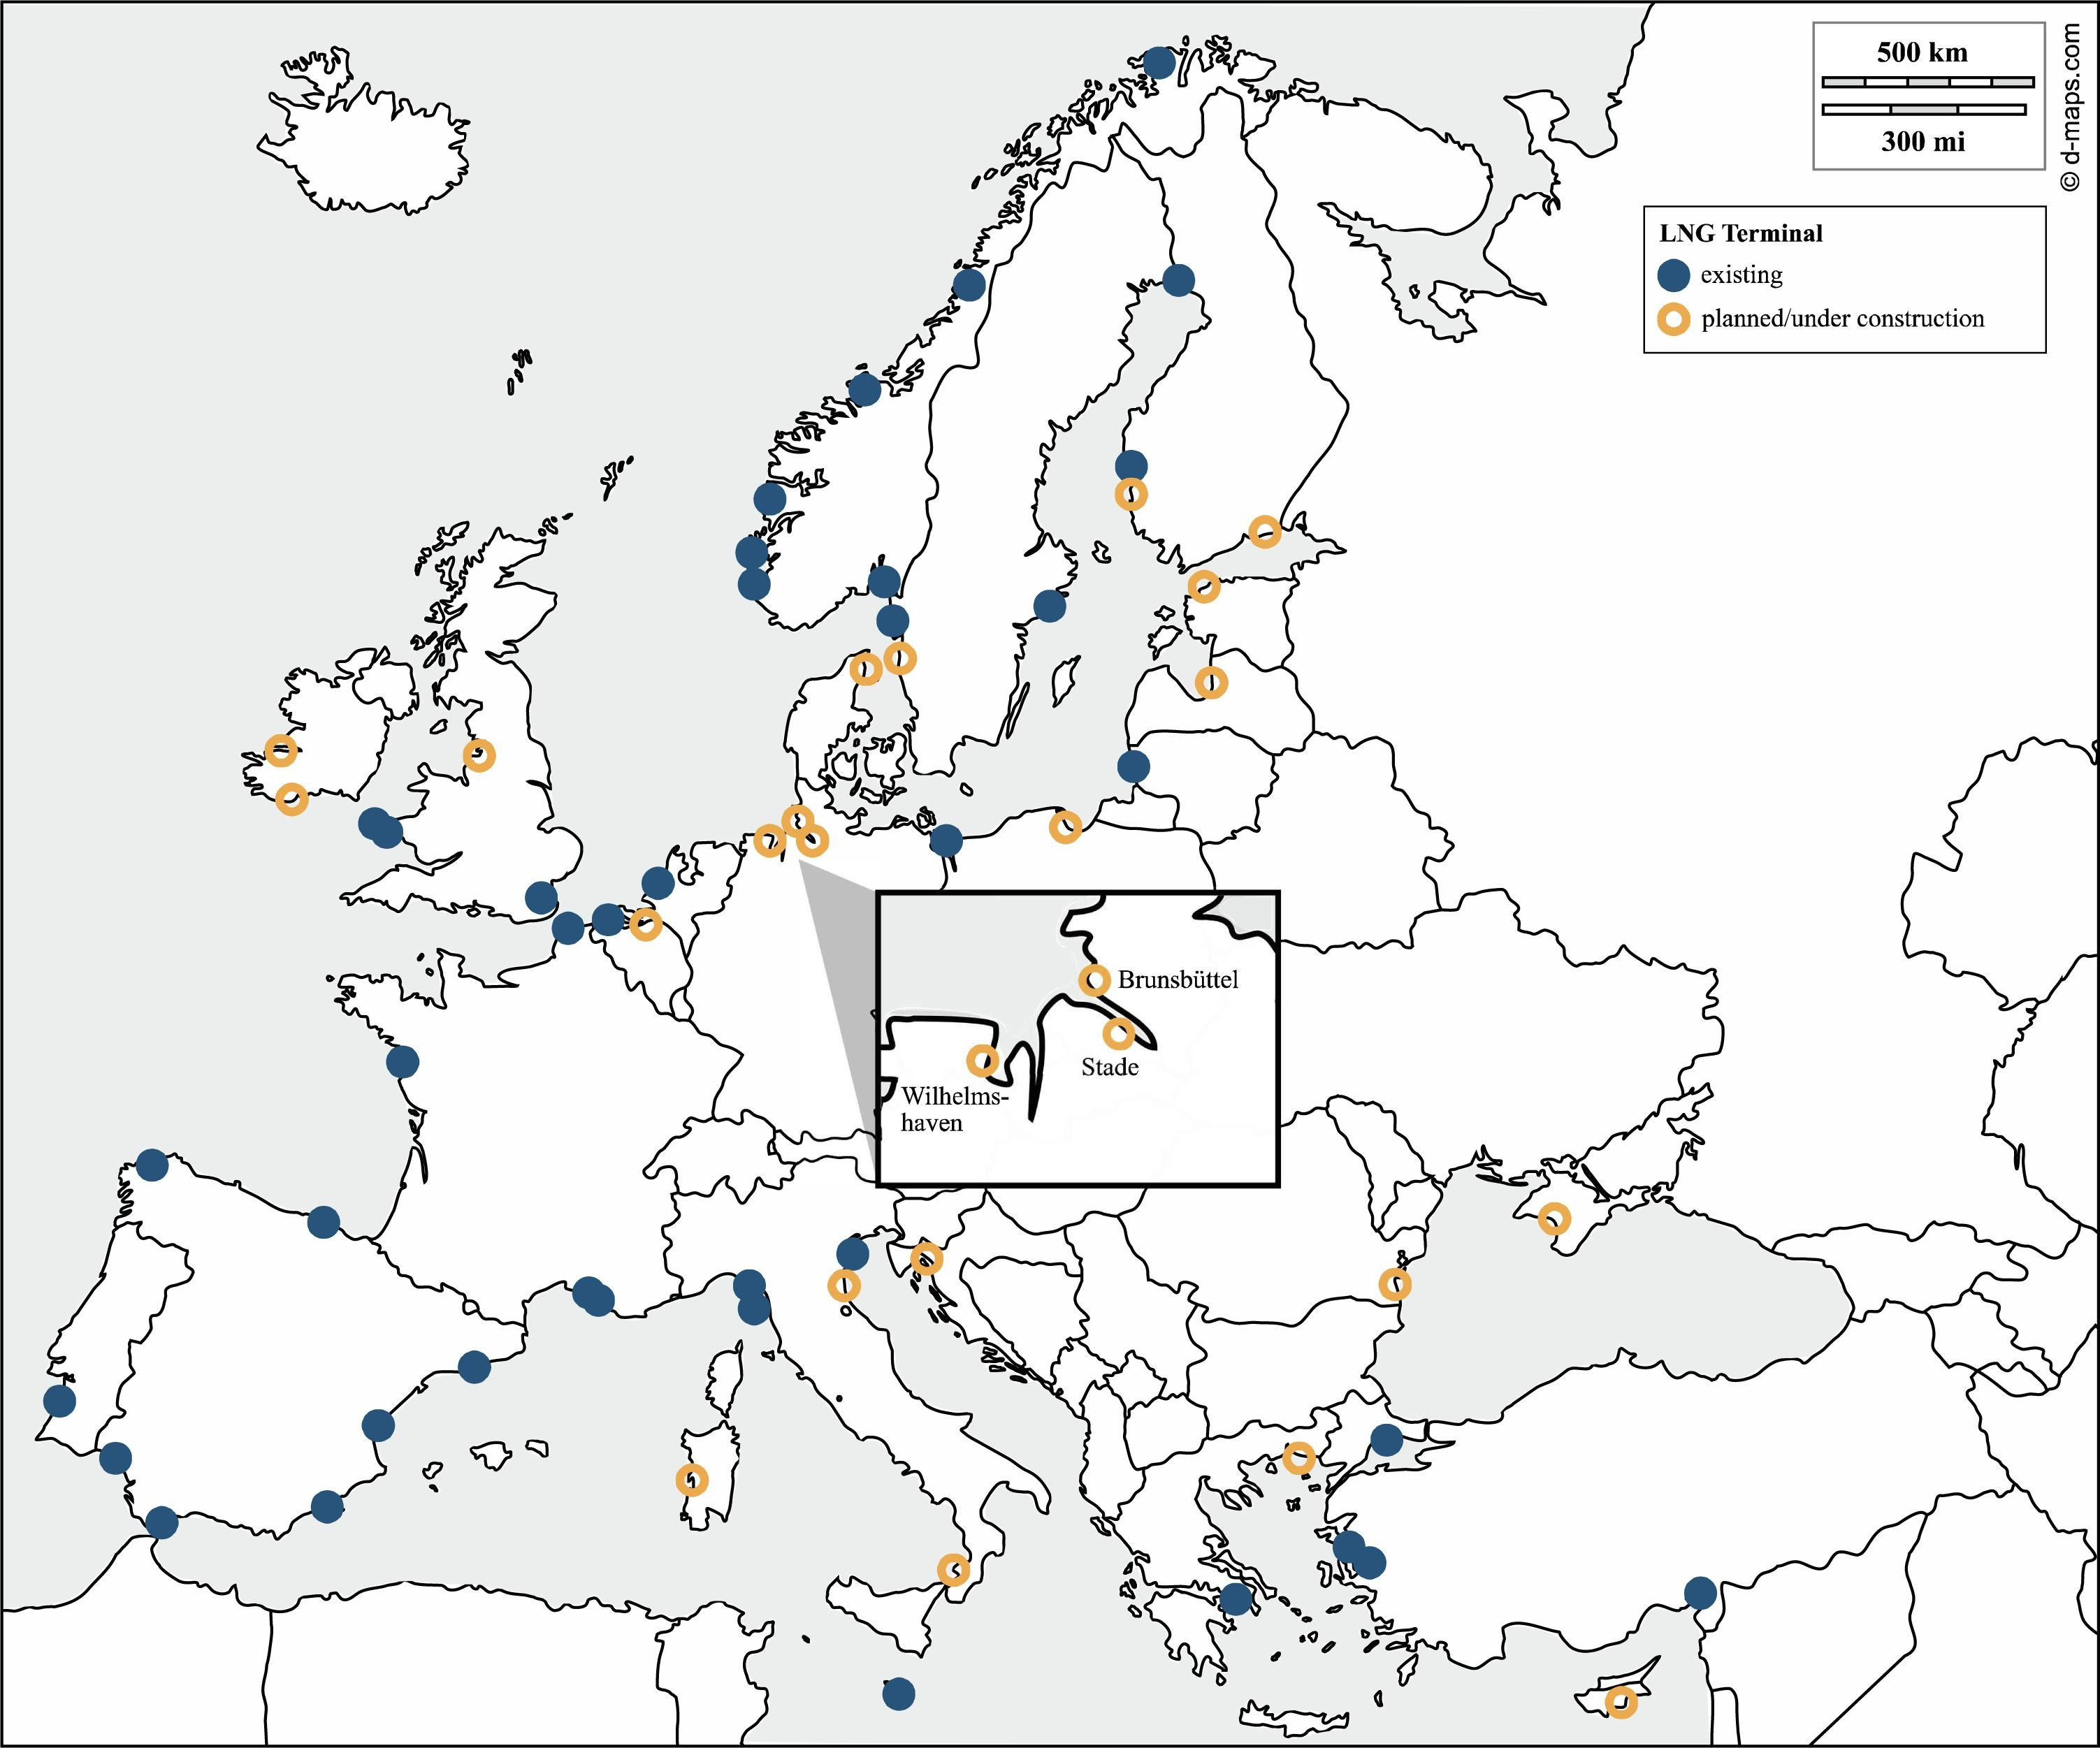
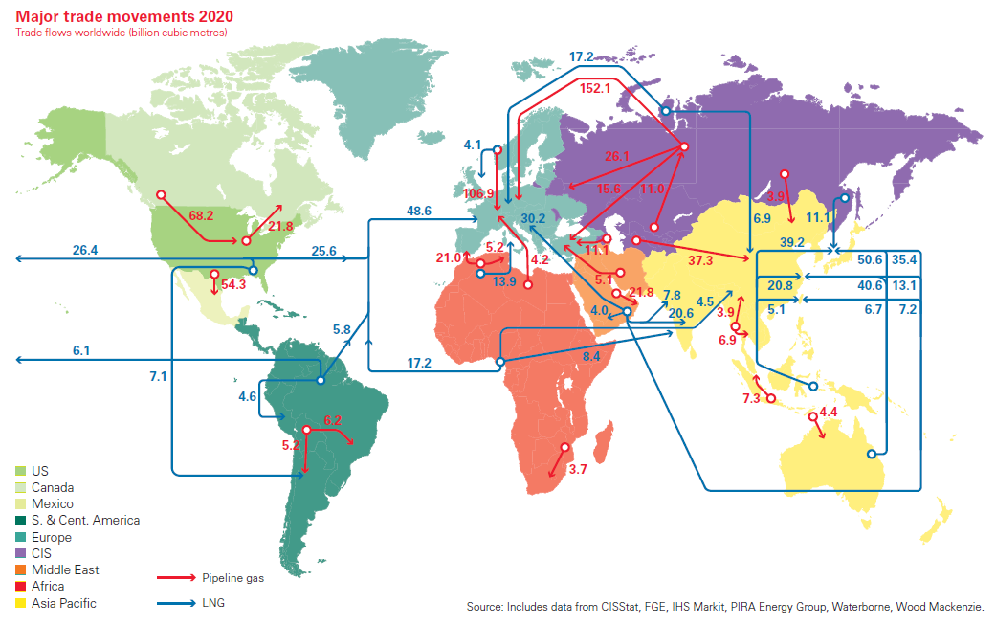
Natural Gas Market
EU Green Deal includes natural gas for low-carbon transition
LNG terminals increase resilience to supply shocks from geopolitical conflicts
Connections with the oil market and price volatility
Increases the inertia of the fossil based energy system with suppliers, value chains and consumers resisting low-carbon transition
Notes:
https://www.bp.com/content/dam/bp/business-sites/en/global/corporate/pdfs/energy-economics/statistical-review/bp-stats-review-2021-natural-gas.pdf
Brauers, H., Braunger, I., & Jewell, J. (2021). Liquefied natural gas expansion plans in Germany: The risk of gas lock-in under energy transitions. Energy Research and Social Science, 76, 102059. https://doi.org/10.1016/j.erss.2021.102059

Slide 17
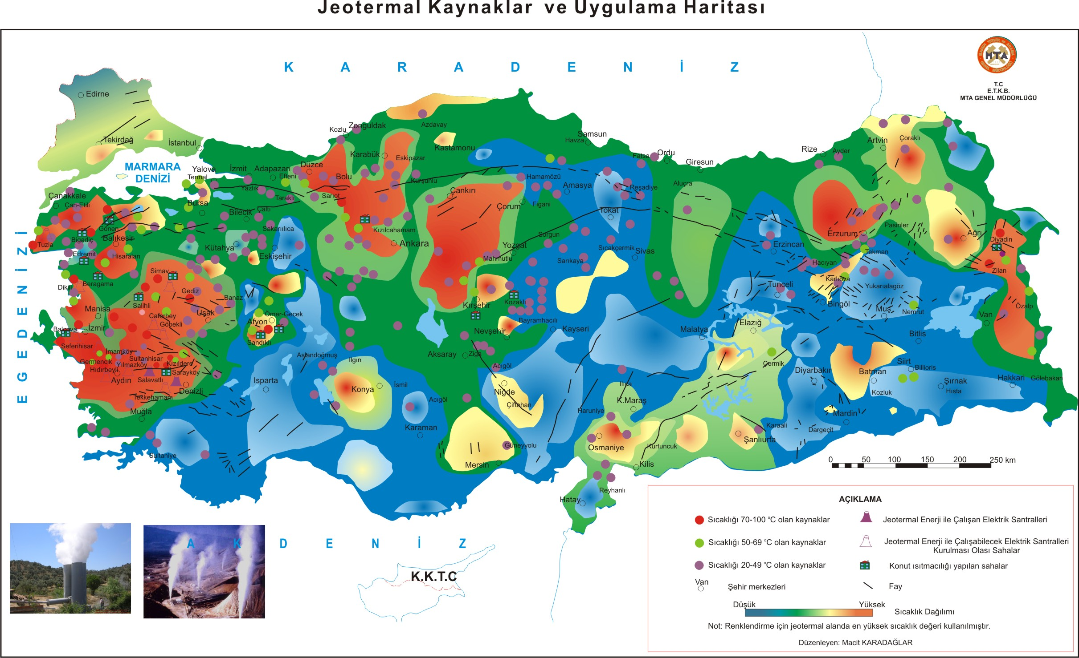
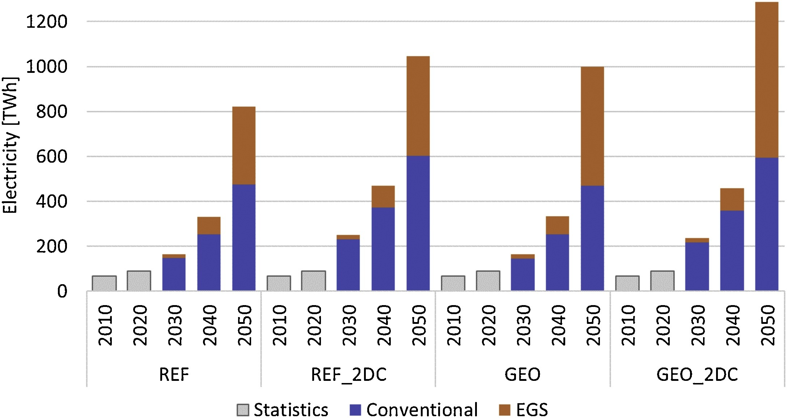
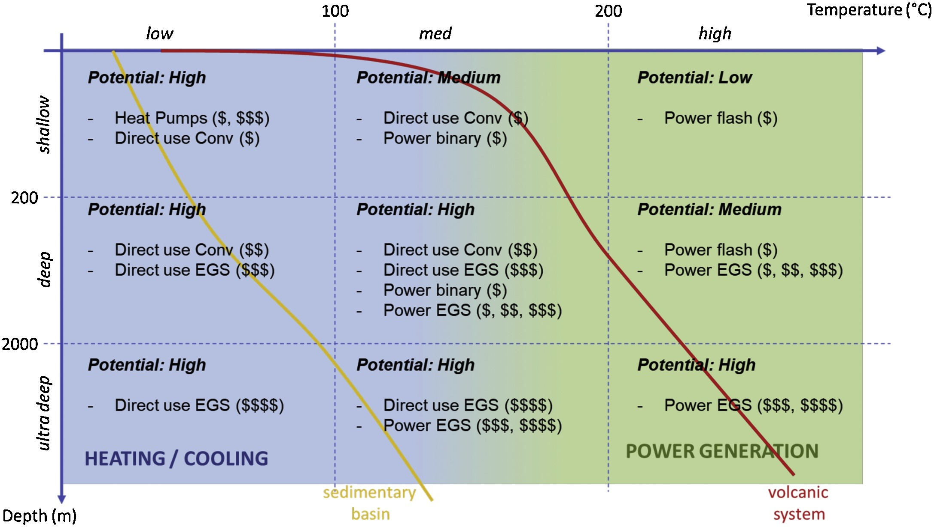
Geothermal Market
A low carbon energy in principle depending on geology and technology
Technology developments (hydraulic fracturing) enables high temperature deep formations for power generation
Climate ambition and cost reductions could favor enhanced geothermal power penetration
Topology of geothermal options in TIAM-ECN, distinguished by 3 potential levels (low, medium, high) and 4 cost levels (existing, low, medium, high: $, $$, $$$, $$$)
Projections with TIAM-ECN for global geothermal electricity generation. Statistical data for 2010 are taken from IEA (2011), for 2020 they are derived from IEA (2019).
Notes:
van der Zwaan, B., & Dalla Longa, F. (2019). Integrated assessment projections for global geothermal energy use. Geothermics, 82, 203–211. https://doi.org/10.1016/j.geothermics.2019.06.008
Flash plants separate high temperature steam (> 180°C) directly from geothermal reservoir fluids, after which it is piped to a turbine to generate electricity. In binary plants heat (> 70°C and<180°C) is recovered from the geothermal fluid to vaporize a fluid with low boiling point that drives a turbine. EGS use hydraulic fracturing (‘fracking’) techniques to increase the permeability and allow for heat recovery from (ultra) deep formations.
https://www.mta.gov.tr/v3.0/hizmetler/jeotermal-harita

Slide 18
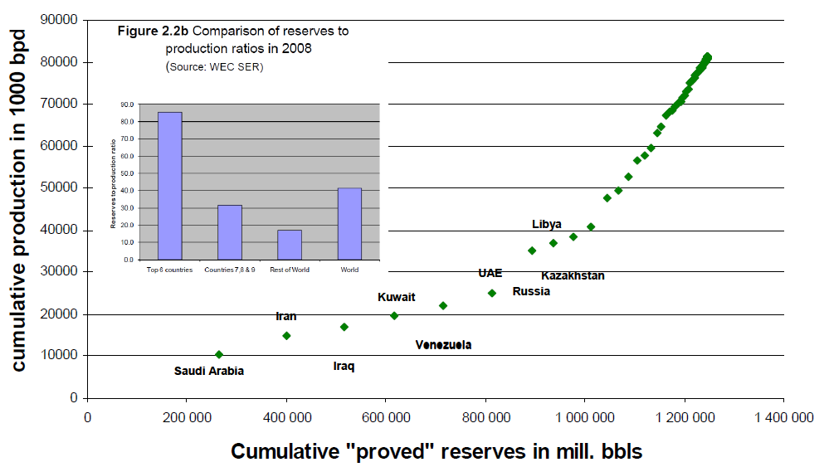
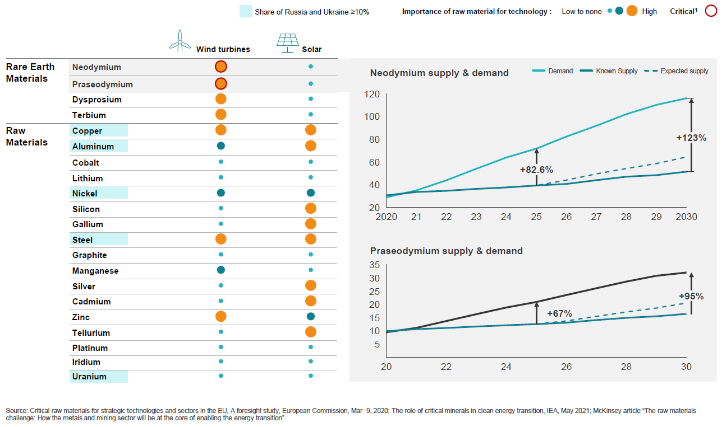
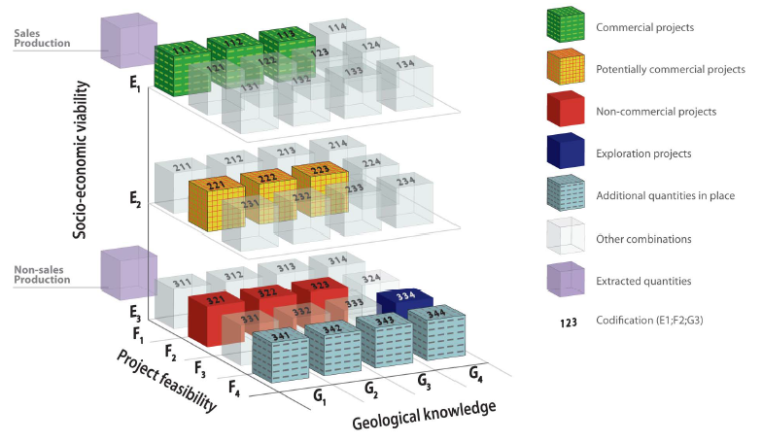
Energy Resources
State economies defined all resources as reserves in the past
Market economies define reserves as resources which can be economically extractable under current market conditions
Energy transition may have strong effect on economics and market conditions
Critical materials for strategic sectors and technologies may effect energy security
Notes:
https://unece.org/fileadmin/DAM/energy/se/pp/unfc/IntWs_UNFC_Ankara_Sept2011/2_Heiberg.pdf
https://europeanclimate.org/resources/delivering-eu-energy-security-through-climate-action/

Slide 19
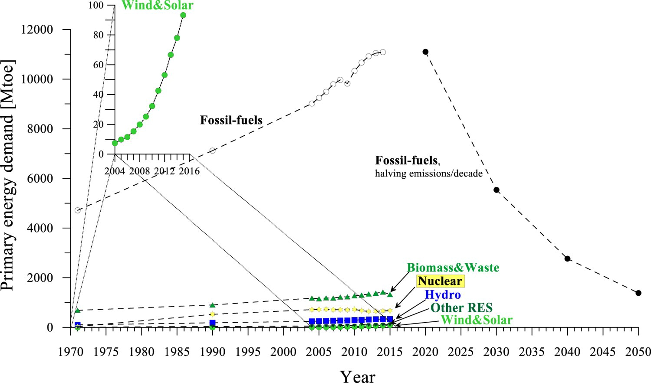
Primary Energy Demand
Historical trends show huge dependence on fossil fuels
Rapid penetration of wind and solar power since 2004
Achievement of climate target requires rapid reduction of fossil fuels reversing the historical trends
Countries with fossil fuel reserves and assests might provide barriers for renewable energy penetration
Policies for decarbonization of final energy demand could pay off better
The filled symbols are approximations of the reduction in fossil fuel consumption required if halving the gross anthropogenic CO2 emissions every decade in line with ‘the Carbon Law’ proposed by Rockström et al. (2017). The filled symbols assume that the ratio between coal, oil and gas is maintained at current levels while halving emissions from fossil fuel use every decade, not considering any offsetting by CCS. For wind, solar and hydro, the ‘physical content method’ is applied, i.e. their electricity output is taken at the point of generation of electricity, and their ‘primary energy equivalent’ is computed as the electricity generated in the plant (not assuming displaced thermal generation, which requires assuming a value for the thermal efficiency of the plant to compute the ‘primary energy equivalent’, i.e. the displaced thermal generation would then be the electricity generated from these plants divided by an assumed thermal efficiency).
Notes:
Johnsson, F., Kjärstad, J., & Rootzén, J. (2019). The threat to climate change mitigation posed by the abundance of fossil fuels. Climate Policy, 19(2), 258–274. https://doi.org/10.1080/14693062.2018.1483885

Slide 20
Market Economy
Complete property rights (well-defined, transferable, secure)
All goods are traded
No externalities
All goods are private (no public goods)
Small agents with price-taking behavior
Complete information of current and future prices and technical capabilities
 | Excludable | Non-excludable
Rival | Pure private goods | Open Access reservoirs (ocean fishing)
Non-Rival | Wilderness area, public transport | Pure public goods (defense, mitigation)
Notes:
Ebru Voyvoda

Slide 21
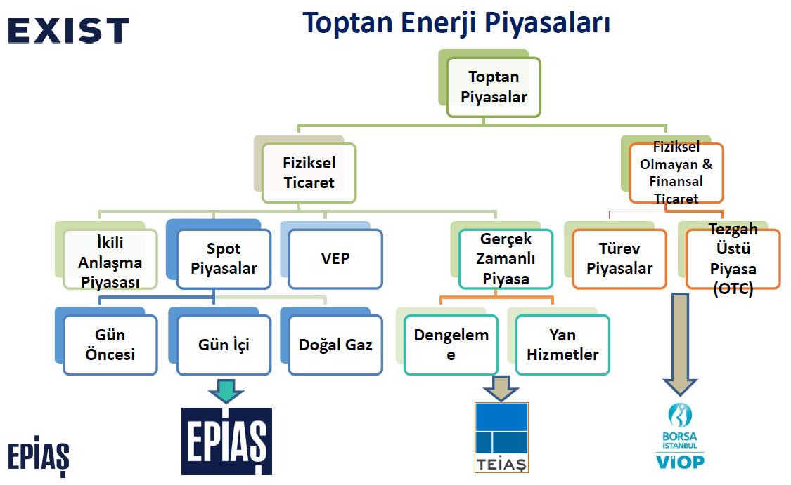
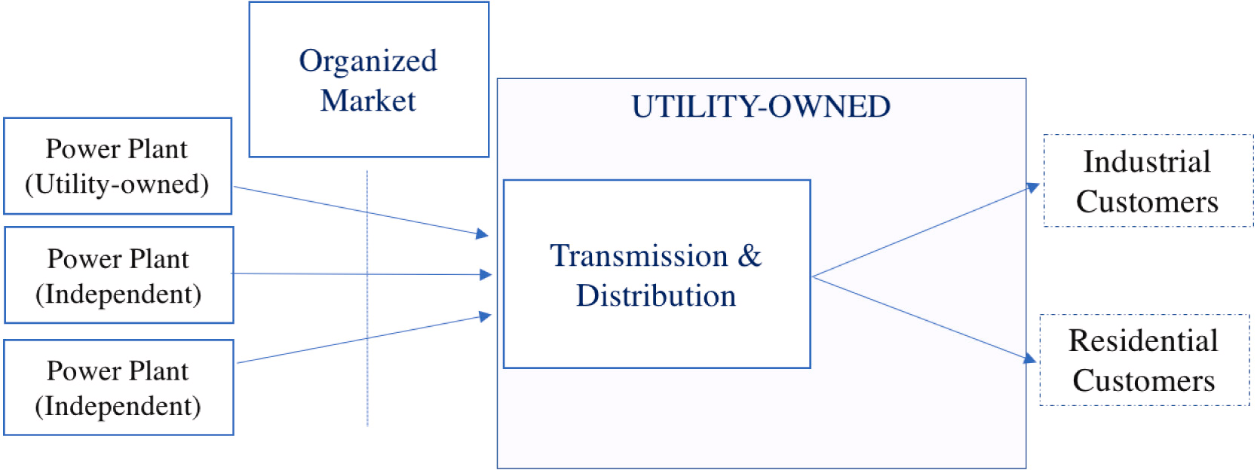
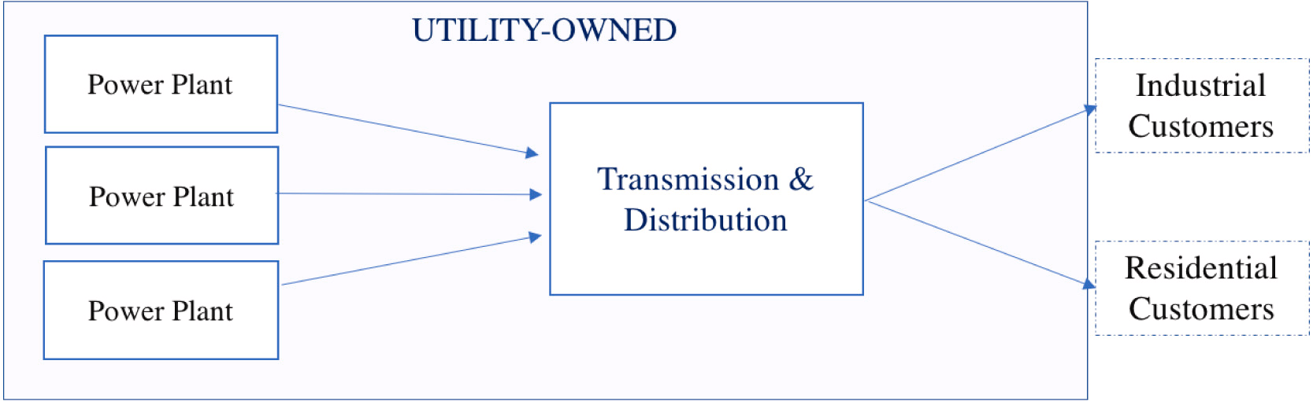
Electricity Market
Transition from legacy to independent power producers with de-regulation
Political dominance of some interest groups might be broken to prevent disproportionate benefits
Countries with deregulated electricity markets may adopt climate policies such as renewable portfolio standards and cap-and-trade programs more easily
Electricity market without competition
Electricity market with competition
Notes:
Lee, N. R. (2020). When competition plays clean: How electricity market liberalization facilitated state-level climate policies in the United States. Energy Policy, 139, 111308. https://doi.org/10.1016/j.enpol.2020.111308

Slide 22
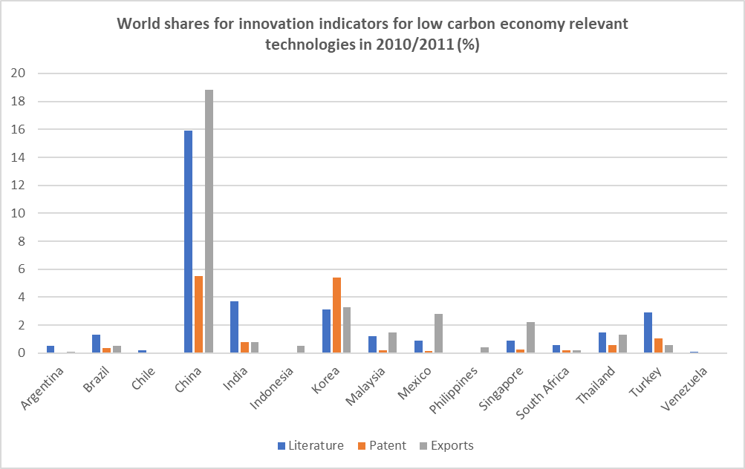
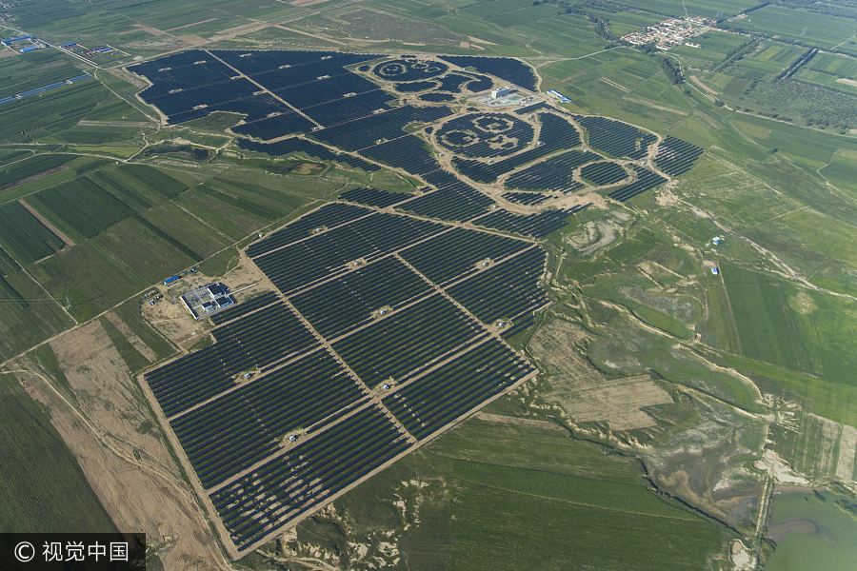
Energy Innovation
Technological innovation: efficiency, technological feasibility, grid balancing and infrastructure planning
Social innovation: alternative business models, policy instruments, financing schemes, governance approaches and new discourses
Trade-offs, unintended consequences and ambiguity might be related with social objectives
A solar power station shaped like giant pandas started operation in Datong, North China's Shanxi province, Aug 14, 2017
Notes:
Wittmayer, J. M., de Geus, T., Pel, B., Avelino, F., Hielscher, S., Hoppe, T., Mühlemeier, S., Stasik, A., Oxenaar, S., Rogge, K. S., Visser, V., Marín-González, E., Ooms, M., Buitelaar, S., Foulds, C., Petrick, K., Klarwein, S., Krupnik, S., de Vries, G., … Härtwig, A. (2020). Beyond instrumentalism: Broadening the understanding of social innovation in socio-technical energy systems. Energy Research & Social Science, 70(December 2019), 101689. https://doi.org/10.1016/j.erss.2020.101689
https://www.chinadaily.com.cn/business/2017-08/15/content_30637294_5.htm#Contentp
Lema, R., Iizuka, M., & Walz, R. (2015). Introduction to low-carbon innovation and development: Insights and future challenges for research. Innovation and Development, 5(2), 173–187. https://doi.org/10.1080/2157930X.2015.1065096

Slide 23
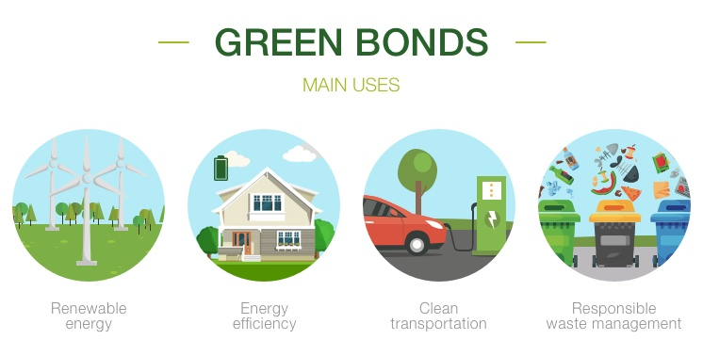
Quiz #1 (Take home)
What are our main energy resources?
Are we a net energy importing or exporting country? Why?
What are the main energy resources for heating and cooking at our homes?
What transport mode do we use for coming to and returning from school?
What do we do to lower our energy and water bills?
How can we accelerate energy innovation?
Open with the take home message (most important thing to share)
Q1: Why are we here?
Q2: Says who?
Q3: So what?
Notes:
https://www.iberdrola.com/sustainability/investments-green-bonds

Slide 24
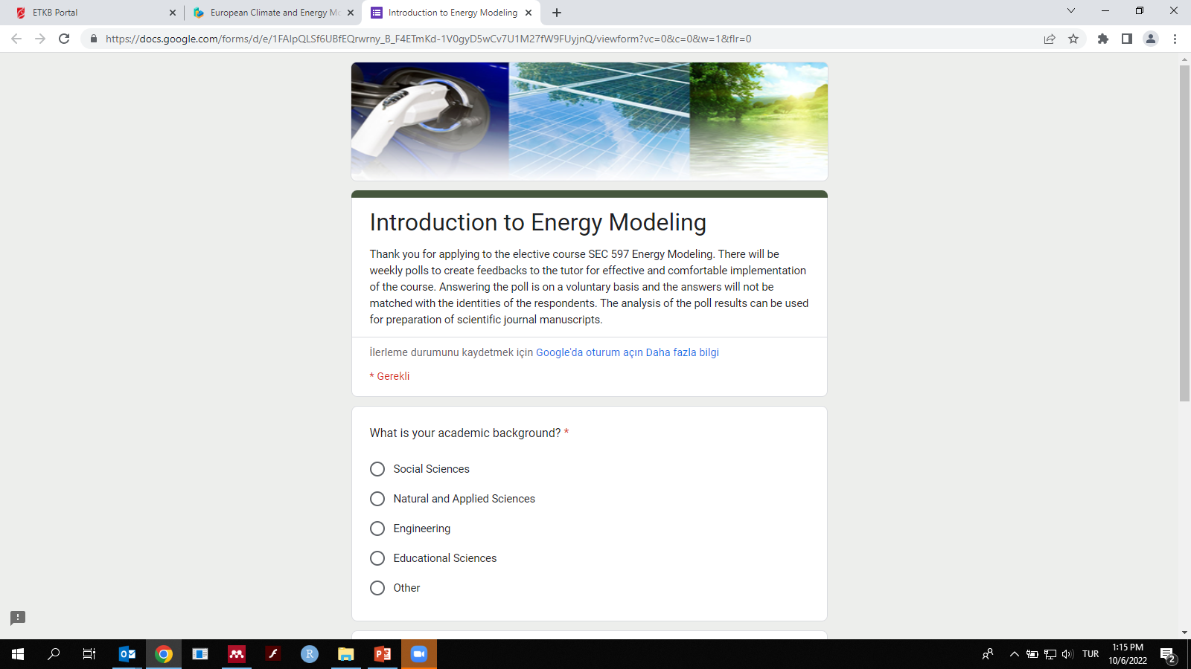
Poll #1

Slide 25
References
[1] Gungor G, Sari R. The Role of Nuclear Energy in Transition Pathways of Turkish Energy Sector. In: The potential role of nuclear energy in national climate change mitigation strategies : final report of a coordinated research project [Internet]. International Atomic Energy Agency (IAEA): IAEA; 2020 .
[2] Gungor G, Sari R. Turkey’s energy system development: linking an energy supply model with an industrial simulation model and solving it iteratively. Int J Innov Sustain Dev [Internet]. 2018. 12(1/2):44.
[3] Gungor G, Sari R. Nuclear power and climate policy integration in developed and developing countries. Renew Sustain Energy Rev [Internet]. 2022. 169(June):112839.
[4] Lee J, Yang JS. Global energy transitions and political systems. Renew Sustain Energy Rev [Internet]. 2019. 115(August):109370.
[5] Castor J, Bacha K, Fuso Nerini F. SDGs in action: A novel framework for assessing energy projects against the sustainable development goals. Energy Res Soc Sci [Internet]. 2020. 68(January):101556.
[6] Siscoe G. The space-weather enterprise: past, present, and future. J Atmos Solar-Terrestrial Phys [Internet]. 2000. 62(14):1223–32.
[7] Malliaris AG, Malliaris M. What Microeconomic Fundamentals Drove Global Oil Prices during 1986–2020? J Risk Financ Manag. 2021. 14(8):391.
[8] Brauers H, Braunger I, Jewell J. Liquefied natural gas expansion plans in Germany: The risk of gas lock-in under energy transitions. Energy Res Soc Sci [Internet]. 2021. 76:102059.
[9] van der Zwaan B, Dalla Longa F. Integrated assessment projections for global geothermal energy use. Geothermics [Internet]. 2019. 82:203–11.
[10] Johnsson F, Kjärstad J, Rootzén J. The threat to climate change mitigation posed by the abundance of fossil fuels. Clim Policy [Internet]. 2019. 19(2):258–74.
[11] Lee NR. When competition plays clean: How electricity market liberalization facilitated state-level climate policies in the United States. Energy Policy [Internet]. 2020. 139:111308.
[12] Wittmayer JM, de Geus T, Pel B, Avelino F, Hielscher S, Hoppe T, et al. Beyond instrumentalism: Broadening the understanding of social innovation in socio-technical energy systems. Energy Res Soc Sci [Internet]. 2020. 70(December 2019):101689.
[13] Lema R, Iizuka M, Walz R. Introduction to low-carbon innovation and development: Insights and future challenges for research. Innov Dev. 2015. 5(2):173–87.

